Slide 1




JISTech 2K21
An approach to solve live societal and industrial problems
Presented By :
Team Insomnians

Slide 2



JISTech2K21
Title of the Project : SLEEP PREVENTION DEVICE
Team ID : BSHU25
Department
Basic Science and Humanities
SEMESTER - 1

Slide 3


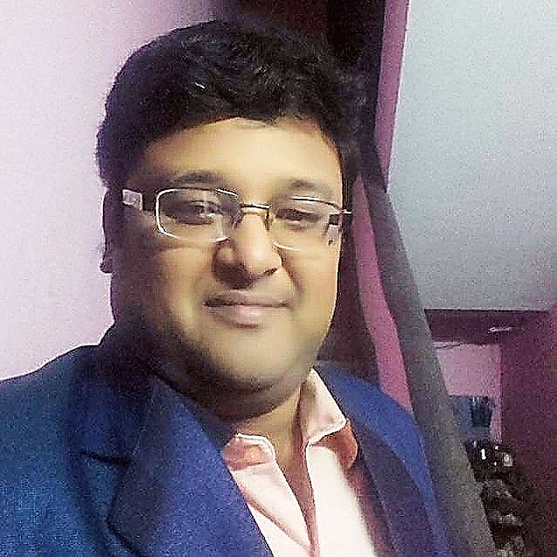
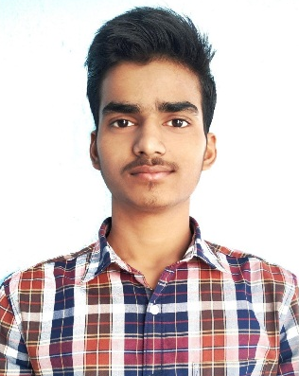


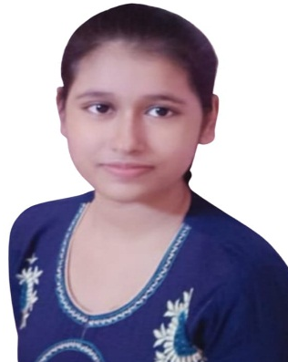
JISTech2K21
Team Members & Mentor :
BAIVAB SARKAR
MR. JIT CHAKRABORTY
HEAD, DEPT. OF CHEMISTRY
ABHISHEK SUMAN
OISHEE MUKHOPADHYAY
TAMAL PUTATUNDA
ANANYA DUTTA

Slide 4

JISTech2K21
Team Contact :
Sl. No | Name of the Students /Innovator | University Roll No | College ID | Mobile no | E-Mail Id
1 | BAIVAB SARKAR | NA | JIS/2021/0381 | 8961428548 | baivabsarkar@gmail.com
2 | TAMAL PUTATUNDA | NA | JIS/2021/0278 | 8420622911 | tamalputatundu@gmail.com
3 | OISHEE MUKHOPADHYAY | NA | JIS/2021/0352 | 7602247757 | oisheemukhopadhyay00@gmail.com
4 | ANANYA DUTTA | NA | JIS/2021/0202 | 9832100519 | ananyadutta.habra@gmail.com
5 | ABHISHEK SUMAN | NA | JIS/2021/0369 | 8789168473 | abhishek478suman@gmail.com

Slide 5

JISTech2K21
Problem Statement :
India is one of the countries with an alarmingly high number of deaths attributed to road accidents.
A study conducted in 2020 revealed that truck drivers in India drive 12 hours a day covering around 417 km, with almost 50% of them admitting that they feel sleepy or tired while driving.
Another study revealed that more than 23% of truck drivers have sleep deprivation.
Clearly, these drowsy drivers can cause fatal accidents on roads.

Slide 6

JISTech2K21
Project Abstract :
Feeling sleepy while driving could cause hazardous traffic accident. However, when driving alone on highway or driving over a long period of time, drivers are inclined to feel bored and sleepy, or even fall asleep. Nowadays most of the products of driver anti-sleep detection sold in the market are simply earphone making intermittent noises, which is quite annoying and inefficient. As such, there is a high demand for cheap and efficient driver sleep detection. Therefore, we came up with an idea and successfully developed a sleepy detection and alarming system, which could effectively meet this demand.

Slide 7

JISTech2K21
Idea towards Problem Solution :
Everyone knows about the alarms that abruptly wake us from our slumbers each morning, but have you heard of alarms that can keep us awake while we're driving? We present - “SLEEP PREVENTION DEVICE“.
Sleep Prevention Device is an device to keep car drivers awake. Although it was designed for car drivers, it can also be used in any other situation where you need to stay awake.
This Sleep Prevention Device reduce distracted driving accidents using only Arduino, MPU6050 and a buzzer. If a driver writes a message and looks down for more than 3 seconds the buzzer is activated. So, if the driver looks down or looks up for more than 3 seconds a buzzer is activated which alerts the driver. This project can also be used as the driver drowsiness detection system.

Slide 8

JISTech2K21
Novelty/uniqueness of the Idea :
The Anti-Sleep Alarm by Seniority has been designed for your head that delivers a high alarm pitch to keep you from dozing off to sleep. The device is meant to be worn on your head . As the driver's head nods below a preset angle, it emits a loud alarm signal with vibration that alerting the driver to take corrective action. The Alarm is not only designed for drivers, it is perfect for people who need to be totally alert while on duty such as security guards, machine operators and even students. This device is the best choice for drivers and very effective in keeping drivers awake. If your head tilts or moves forward more than 30 degrees, a high-pitched alarm will ring with vibration. This smart device ensures your safety and keeps you aware and awake. Good to use while working, driving and studying!

Slide 9

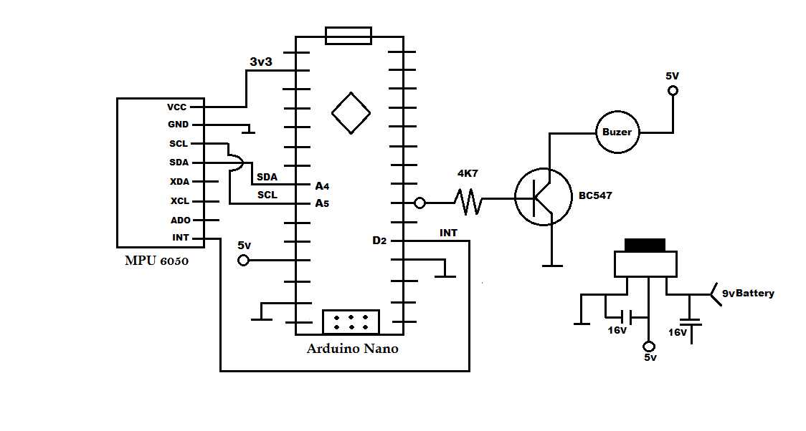
JISTech2K21
Circuit Diagram Related to Project :

Slide 10


JISTech2K21
Video to support your Idea :

Slide 11
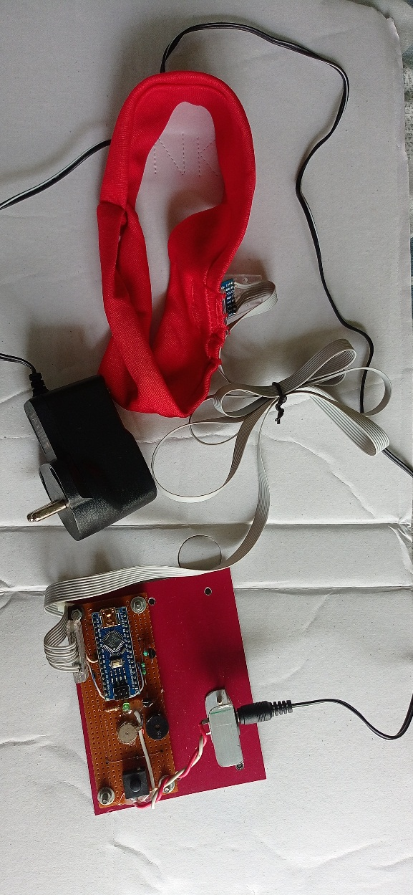
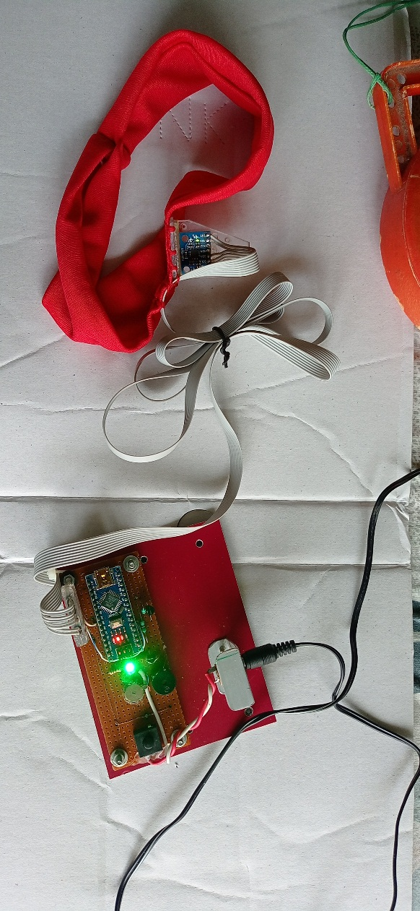

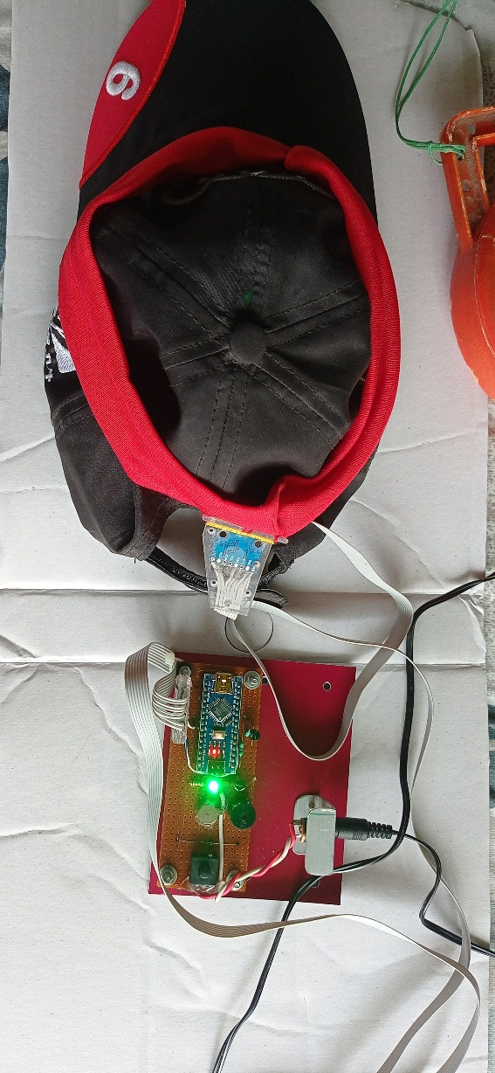
JISTech2K21
Image of Device Developed till Date :
COMPLETED

Slide 12

JISTech2K21
Outcome of the Project & Social Impact :
This Sleep Prevention Device alerts the driver if he/she falls asleep at the car thereby, avoiding accidents and saving their lives. This system is useful especially for people who travel long distances and people who are driving late at night.
This device is designed for drivers to save their lives from accidents and it aims to prevent the drivers from drowsiness and create a safer driving environment. Hence, it's good to use while driving.

Slide 13

JISTech2K21
Price Involved in Developing a Single Unit :
Sl No. | Items | Quantity | Amount(Rs.) | Justification
1 | MPU6050 - Triple Axis Gyro Accelerometer Module | 1 | 649.00 | Needed in the circuit
2 | Arduino NANO | 1 | 419.00 | Needed in the circuit
3 | SMPS 5V/1A | 1 | 150.00 | Needed in the circuit
4 | Vibrator | 1 | 129.00 | Needed in the circuit
5 | ON/OFF Switch | 1 | 20.00 | Needed in the circuit
6 | Piezo electric buzzer | 1 | 20.00 | Needed in the circuit
7 | Power Connector | 1 | 30.00 | Needed in the circuit
Total |  |  | 1,417.00

Slide 14

JISTech2K21
Feasibility of Project in terms of prototype,
product development :
The project prototype is READY.
Business application :
It may be widely used by the leading car companies and can be made compulsory to be placed inside cars by the Government.

Slide 15

JISTech2K21
Future Scope :
The drowsiness detection proposed here is a minimum intrusive approach for monitoring driver drowsiness, based on triple axis gyro accelerometer module. Results obtained with the system are similar or even better than other commercial ones being more flexible and open source.
The commercial systems often require a non-trivial calibration procedure, to adjust the detection. This method is accurate up to 98%.
This method of drowsiness detection takes less computational in very less time. Hence, it is very advantageous to use this technique in the real time applications.
This device can sense real time movement processing and detection. This device can alert the driver by sound and vibration. This device has little inference and potential hazard to driver’s normal driving.

Slide 16

JISTech2K21

